Slide 1
Fall, 2021
Lecture 06: Principles of Integration Evaluation

Slide 2
Contents
1
Integration by parts
2
Trigonometric Integrals
3
Trigonometric substitutions
4
Integrating rational function by Partial Factions
5
Integration strategies
6
Improper Integrals

Slide 3
An overview of integration methods

Slide 4
Integration method overview
Methods for approaching integration problems:
Technology – use a CAS (Computer Algebra System) program to evaluate (or approximate) complicated integrals
Tables – are used prior to the development of CAS program.
Transformation methods – convert unfamiliar integrals into familiar integrals
u-substitutions, Integration by parts
algebraic manipulation, other methods
A review of familiar integral formulas
See textbook page 489.

Slide 5
Integration By parts

Slide 6
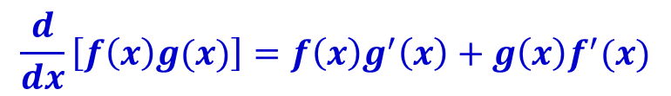

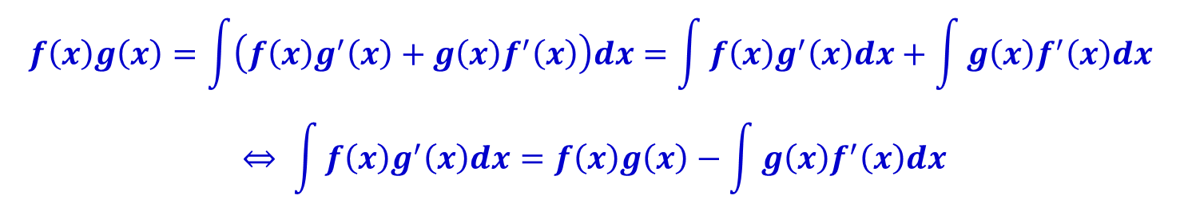
Integration by parts
A method to evaluate the integrals of the form by using the Product Rule for differentiation
Recall to the Product Rule for differentiation
We can express this equation in integral form as:
$$\int{f\left(x\right)g(x)dx}$$
$$\frac{d}{dx}\left[f\left(x\right)g(x)\right]=f\left(x\right)g^{′}\left(x\right)+g\left(x\right)f^{′}(x)$$
$$f\left(x\right)g\left(x\right)=\int{\left(f\left(x\right)g^{′}\left(x\right)+g\left(x\right)f^{′}\left(x\right)\right)dx}=\int{f\left(x\right)g^{′}\left(x\right)dx}+\int{g\left(x\right)f^{′}\left(x\right)dx}$$
$$⇔ \int{f\left(x\right)g^{′}\left(x\right)dx}=f\left(x\right)g\left(x\right)−\int{g\left(x\right)f^{′}\left(x\right)dx}$$

Slide 7
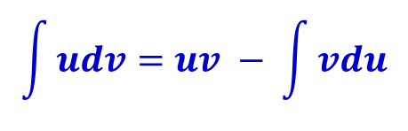
Integration by parts
It is perhaps easier to remember if we use the following notation.
Let u=f(x) and v=g(x)
Then, du=f’(x)dx and dv=g’(x)dx.
The integration by parts formula becomes
$$\int{udv=uv − \int{vdu}}$$

Slide 8
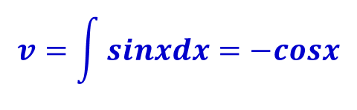

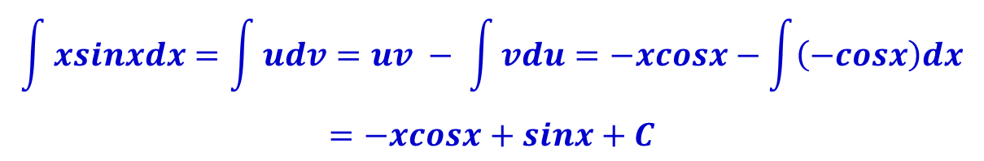
Integration by parts : Example
Evaluate
Solution:
Let u=x and dv=sinxdx Then, du=dx and
Applying integration by parts formula
$$\int{xsinxdx}$$
$$v=\int{sinxdx}=−cosx$$
$$\int{xsinxdx}=\int{udv=uv − \int{vdu}}=−xcosx−\int{\left(−cosx\right)dx}$$
$$=−xcosx+sinx+C$$

Slide 9


Integration by parts: How to choose u and dv
Our aim in using integration by parts is to obtain a simpler integral than the one we started with.
In the example, we started with
By choosing u=x, dv=sinxdx and applying integration by parts formula we expressed it in term of a simpler integral
$$\int{xsinxdx}$$
$$\int{cosxdx}$$

Slide 10
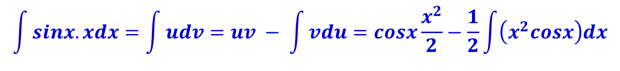
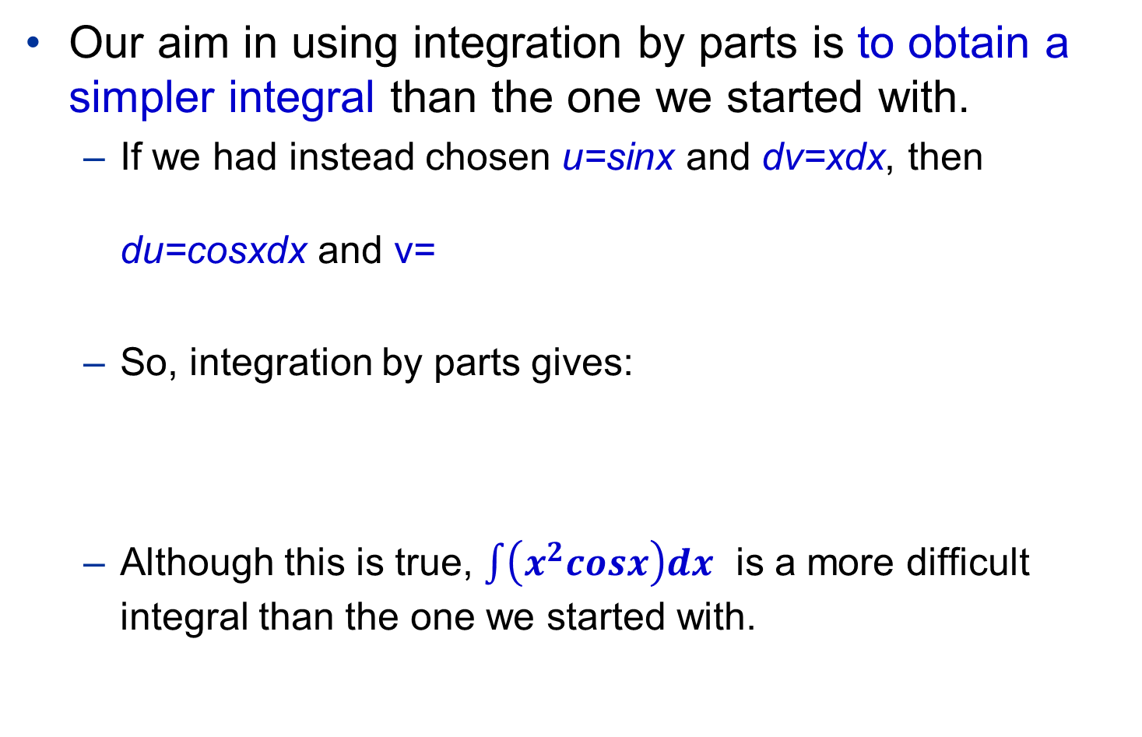

Integration by parts: How to choose u and dv
Our aim in using integration by parts is to obtain a simpler integral than the one we started with.
If we had instead chosen u=sinx and dv=xdx, then du=cosxdx and v=
So, integration by parts gives:
Although this is true, $\int{\left(x^{2}cosx\right)dx}$ is a more difficult integral than the one we started with.
$$\frac{x^{2}}{2}$$
$$\int{sinx.xdx}=\int{udv=uv − \int{vdu}}=cosx\frac{x^{2}}{2}−\frac{1}{2}\int{\left(x^{2}cosx\right)dx}$$

Slide 11

Integration by parts: How to choose u and dv
Hence, when choosing u and dv, we usually try to keep u = f(x) to be a function that becomes simpler when differentiated.
And make sure that dv = g’(x)dx can be readily integrated to give v.
Example Evaluate
Solution: Let u=lnx and dv=dx (we choose u=lnx because the derivative of function f(x)=lnx is simpler than f)
$$\int{\ln{x}dx}$$

Slide 12
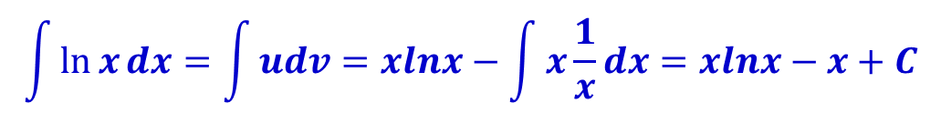

Integration by parts: Example
$$\int{\ln{x}dx}$$
Evaluate
Solution: Let u=lnx and dv=dx (we choose u=lnx because the derivative of function f(x)=lnx is simpler than f)
Then,
$$\int{\ln{x}dx}=\int{udv}=xlnx−\int{x\frac{1}{x}dx}=xlnx−x+C$$

Slide 13
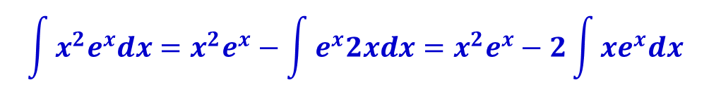


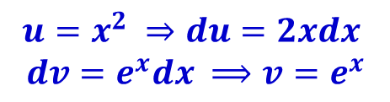
Integration by parts: Example
$$\int{x^{2}e^{x}dx}$$
Evaluate
Solution:
Notice that x² becomes simpler when differentiated.
e^{x} is unchanged when differentiated or integrated.
So we choose
Then,
The integral that we obtained is simpler than the original one. But it is still not obvious, we need more steps
$$u=x^{2} ⇒du=2xdx$$
$$dv=e^{x}dx ⟹v=e^{x}$$
$$\int{x^{2}e^{x}dx}=x^{2}e^{x}−\int{e^{x}2xdx}=x^{2}e^{x}−2\int{{xe}^{x}dx}$$
$$\int{xe^{x}dx}$$

Slide 14
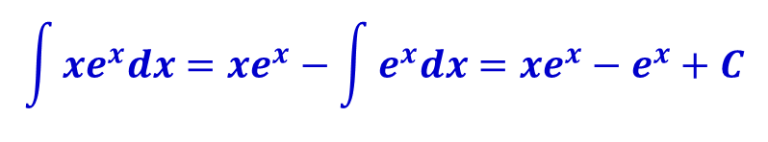

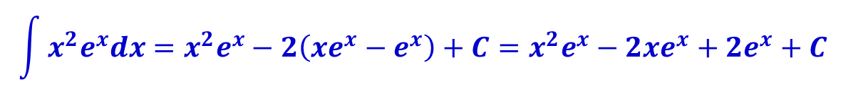
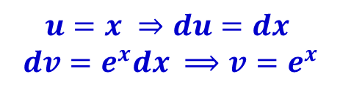
Integration by parts: Example
$$\int{xe^{x}dx}$$
Evaluate
This time we choose:
Then,
Putting the results together:
$$u=x ⇒du=dx$$
$$dv=e^{x}dx ⟹v=e^{x}$$
$$\int{xe^{x}dx}=xe^{x}−\int{e^{x}dx}=xe^{x}−e^{x}+C$$
$$\int{x^{2}e^{x}dx}=x^{2}e^{x}−2\left(xe^{x}−e^{x}\right)+C=x^{2}e^{x}−2xe^{x}+2e^{x}+C$$

Slide 15
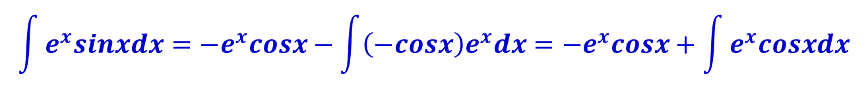


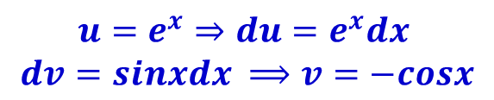
Integration by parts: Example
$$\int{e^{x}sinxdx}$$
Evaluate
Solution:
Notice that e^{x} does not become simpler when differentiated.
Neither does sinx become simpler
Nevertheless, we try choosing
Then,
The integral that we obtained is not simpler than the original one. But at least, it’s no more difficult.
$$u=e^{x}⇒du=e^{x}dx$$
$$dv=sinxdx ⟹v=−cosx$$
$$\int{e^{x}sinxdx}=−e^{x}cosx−\int{{\left(−cosx\right)e}^{x}dx}={−e}^{x}cosx+\int{e^{x}cosxdx}$$
$$\int{e^{x}cosxdx}$$

Slide 16
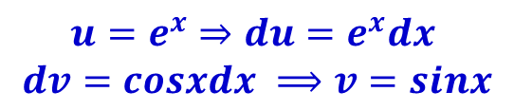
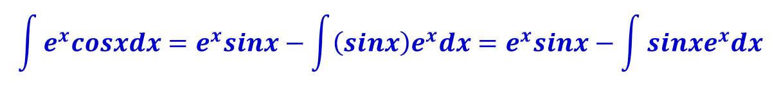
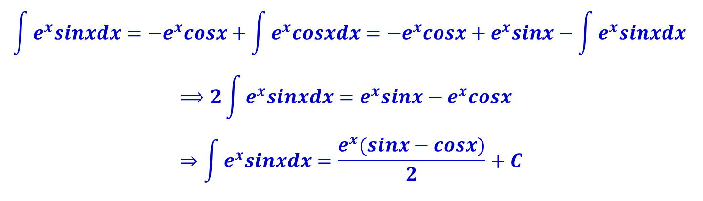
Integration by parts: Example
We continue integrating by parts, let
Then,
Putting results together
$$u=e^{x}⇒du=e^{x}dx$$
$$dv=cosxdx ⟹v=sinx$$
$$\int{e^{x}cosxdx}=e^{x}sinx−\int{{\left(sinx\right)e}^{x}dx}=e^{x}sinx−\int{{sinxe}^{x}dx}$$
$$\int{e^{x}sinxdx}={−e}^{x}cosx+\int{e^{x}cosxdx}={−e}^{x}cosx+e^{x}sinx−\int{e^{x}sinxdx}$$
$$⟹2\int{e^{x}sinxdx}=e^{x}sinx−e^{x}cosx \\ ⇒\int{e^{x}sinxdx}=\frac{e^{x}(sinx−cosx)}{2}+C$$

Slide 17
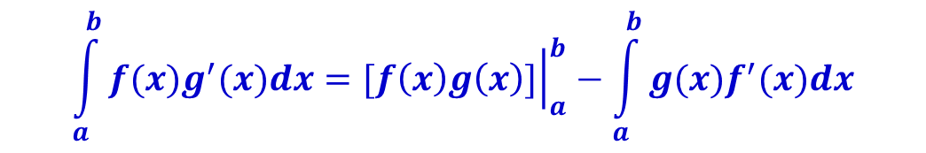
Definite integrals by parts
Combining integration by parts and the fundamental theorem of calculus
$$\int_{a}^{b}{f(x)g^{′}(x)dx}={\left.[f\left(x\right)g\left(x\right)]\right|}_{a}^{b}−\int_{a}^{b}{g(x)f^{′}(x)dx}$$

Slide 18
Trigonometric integrals

Slide 19
Trigonometric integrals
How to use trigonometric identities to integrate certain combinations of trigonometric functions.
A table summarizes the identities of trigonometric functions is posted on course website.
Integrating powers of sine and cosine
Integrating product of sine and cosine

Slide 20
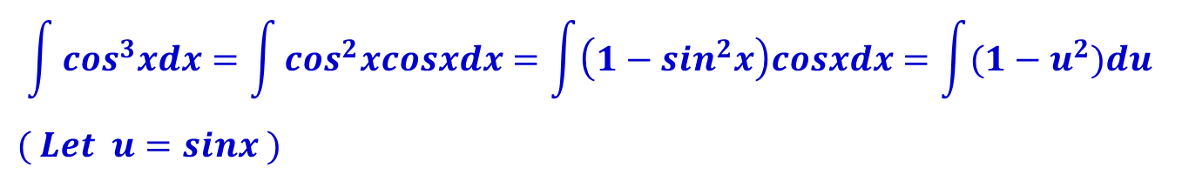

Integrating power of sine and cosine
$$\int{\cos^{3}xdx}$$
Evaluate
Solution:
Simply substituting u=cosx isn’t helpful, since then du=-sinxdx.
In order to integrate powers of cosine, we would need an extra sinx factor. Similarly, a power of sine would require an extra cosx factor.
Thus, we can transform:
$$\int{\cos^{3}xdx}=\int{\cos^{2}xcosxdx}=\int{\left(1−\sin^{2}x\right)cosxdx}=\int{(1−u^{2})du}$$
$$( Let u=sinx )$$

Slide 21

Integrating power of sine and cosine
In the preceding example, an odd power of sine or cosine enabled us to separate a single factor and convert the remaining even power.
If the integrand contains even powers of both sine and cosine, this strategy fails.
Evaluate
If we write sin²x = 1 - cos²x, the integral is no simpler to evaluate.
We must use different techniques
$$\int{\sin^{2}xdx}$$

Slide 22
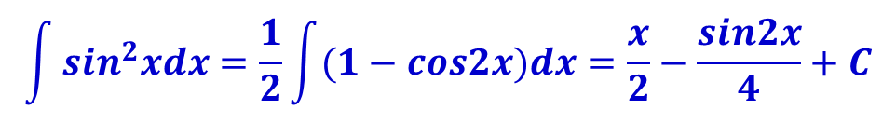

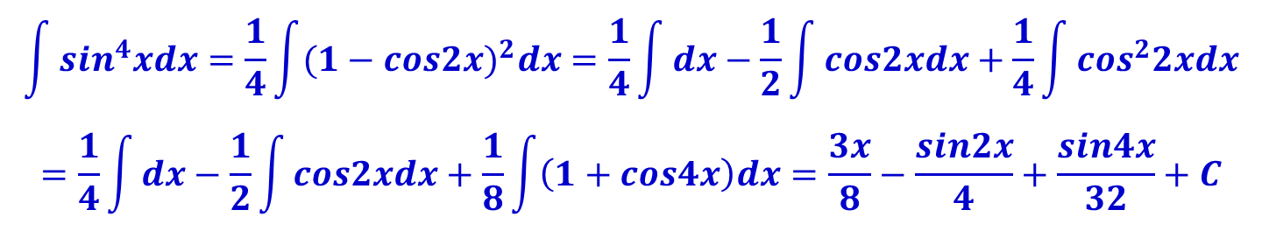

Integrating power of sine and cosine
$$\int{\sin^{2}xdx}$$
Evaluate
Using double angle formula for sinx, we have
Evaluate
Using the same strategy:
$$\int{\sin^{2}xdx}=\frac{1}{2}\int{(1−cos2x)dx}=\frac{x}{2}−\frac{sin2x}{4}+C$$
$$\int{\sin^{4}xdx}$$
$$\int{\sin^{4}xdx}=\frac{1}{4}\int{{(1−cos2x)}^{2}dx}=\frac{1}{4}\int{dx}−\frac{1}{2}\int{cos2xdx}+\frac{1}{4}\int{\cos^{2}2xdx}$$
$$=\frac{1}{4}\int{dx}−\frac{1}{2}\int{cos2xdx}+\frac{1}{8}\int{\left(1+cos4x\right)dx}=\frac{3x}{8}−\frac{sin2x}{4}+\frac{sin4x}{32}+C$$

Slide 23
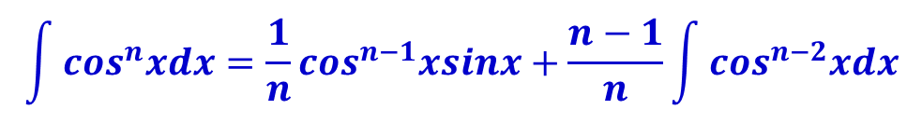
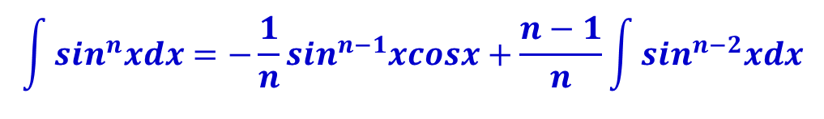
Integrating power of sine and cosine
Reduction formula:
These formulas can be proven using integration by parts
$$\int{\sin^{n}xdx}=−\frac{1}{n}\sin^{n−1}xcosx+\frac{n−1}{n}\int{\sin^{n−2}xdx}$$
$$\int{\cos^{n}xdx}=\frac{1}{n}\cos^{n−1}xsinx+\frac{n−1}{n}\int{\cos^{n−2}xdx}$$

Slide 24
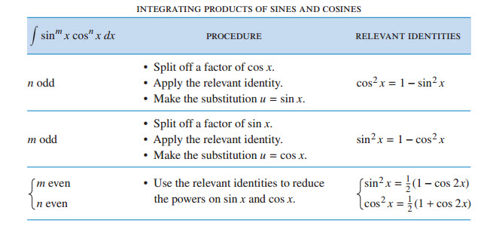

Integrating product of sine and cosine
Evaluate the following integrals:
$$\int{\sin^{m}x\cos^{n}xdx}$$

Slide 25
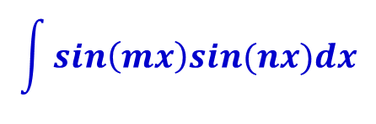
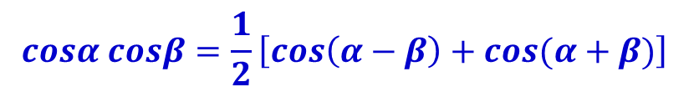
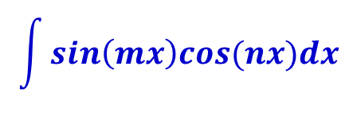
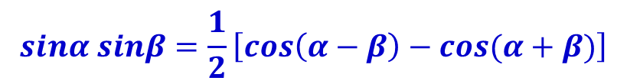
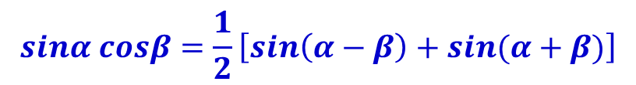
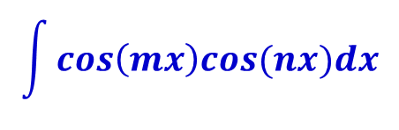
Integrating product of sine and cosine
Evaluate the following integrals:
Using the sum & product trigonometric identities
$$\int{sin\left(mx\right)cos(nx)dx}$$
$$\int{sin\left(mx\right)sin(nx)dx}$$
$$\int{cos\left(mx\right)cos(nx)dx}$$
$$sinα cosβ=\frac{1}{2}\left[sin\left(α−β\right)+sin(α+β)\right]$$
$$sinα sinβ=\frac{1}{2}\left[cos\left(α−β\right)−cos(α+β)\right]$$
$$cosα cosβ=\frac{1}{2}\left[cos\left(α−β\right)+cos(α+β)\right]$$

Slide 26
Trigonometric Substitution

Slide 27




Trigonometric substitution
In finding the area of a circle or an ellipse, an integral of the form arises, where a > 0.
If it were , the substitution would be effective.
However, as it stands, is more difficult.
We apply a method named trigonometric substitution, changing variable form x to t by the substitution x = a sin t
$$\int{\sqrt{a^{2}−x^{2}}dx}$$
$$\int{x\sqrt{a^{2}−x^{2}}dx}$$
$$u=a^{2}−x^{2}$$
$$\int{\sqrt{a^{2}−x^{2}}dx}$$

Slide 28


Trigonometric substitution
Notice the difference between the substitution u = a² – x² and the substitution x = a sin t.
In the first, the new variable is a function of the old one.
In the second, the old variable is a function of the new one.
With the substitution x = a sin t, where
$$−\frac{π}{2}≤t≤\frac{π}{2}$$
$$\int{\sqrt{a^{2}−x^{2}}dx}=\int{\sqrt{a^{2}−a^{2}\sin^{2}t}(acost)dt}=\int{a^{2}\cos^{2}tdt}$$

Slide 29




Trigonometric substitution: Example
$$\int{\frac{\sqrt{9−x^{2}}}{x^{2}}dx}$$
Evaluate
Solution: Let
Now, we must return to the original variable x.
$$x=3sint ,where −\frac{π}{2}≤t≤\frac{π}{2}$$
$$dx=3costdt$$
$$\int{\frac{\sqrt{9−x^{2}}}{x^{2}}dx}=\int{\frac{\sqrt{9−9\sin^{2}t}}{9\sin^{2}t}3costdt}=\int{\frac{\cos^{2}t}{\sin^{2}t}dt}$$
$$\int{\frac{\cos^{2}t}{\sin^{2}t}dt}=\int{\frac{1}{\sin^{2}t}dt}−\int{dt}=−cot(t)−t+C$$

Slide 30


Trigonometric substitution: Example
$$\int{\frac{\sqrt{9−x^{2}}}{x^{2}}dx}$$
Evaluate
Solution: Now, we must return to the original variable x.
$$x=3sint⇒cost=\frac{\sqrt{9−x^{2}}}{3} ;t=arcsin(\frac{x}{3})$$
$$\int{\frac{\sqrt{9−x^{2}}}{x^{2}}dx}=−cot(t)−t+C=−\frac{\sqrt{9−x^{2}}}{x}−arcsin\left(\frac{x}{3}\right)+C$$

Slide 31

Trigonometric substitution
Table summarize the method

Slide 32
Integrating rational functions

Slide 33



Integrating rational functions
Let’s consider the integrations of a rational functions: where P(x) and Q(x) are polynomials
Consider it’s possible to express f as a sum of simpler fractions if the degree of P is less than the degree of Q.
If the degree of P is greater than the degree of Q, we can divide P by Q to receive: where the degree of R is less than the degree of Q.
$$\int{\frac{P(x)}{Q(x)}dx}$$
$$f\left(x\right)=\frac{P(x)}{Q(x)}$$
$$\frac{P(x)}{Q(x)}=S\left(x\right)+\frac{R(x)}{Q(x)}$$

Slide 34




Integrating rational functions
$$f\left(x\right)=\frac{P(x)}{Q(x)}$$
Consider it’s possible to express f as a sum of simpler fractions if the degree of P is less than the degree of Q.
We can express f as the following sum: where F₁(x), F₂(x), …,F_{n}(x) are rational functions of the form: or
$$f\left(x\right)=\frac{P(x)}{Q(x)}=F_{1}(x)+F_{2}(x)+…+F_{n}(x)$$
$$\frac{A}{{(ax+b)}^{k}}$$
$$\frac{Ax+B}{{(ax^{2}+bx+c)}^{l}}$$

Slide 35



Integrating rational functions
$$f\left(x\right)=\frac{P(x)}{Q(x)}$$
To find the decomposition form of the first step is to factor Q(x) completely into linear or irreducible quadratic factors.
After this step, Q(x) is expressed as a product of distinct factor of the form:
Then the following rules can be applied:
${(ax+b)}^{m} or {(ax^{2}+bx+c)}^{n}$

Slide 36

Integrating rational functions
Then the following rules can be applied:

Slide 37



Integrating rational functions: Example
$$\int{\frac{x^{2}+2x−1}{2x^{3}+3x^{2}−2x}dx}$$
Evaluate
Solution: We factor the denominator as:
Applying linear factors rule, we have:
To determine A, B and C:
$$2x^{3}+3x^{2}−2x=x\left(2x^{2}+3x−2\right)=x(2x−1)(x+2)$$
$$\frac{x^{2}+2x−1}{2x^{3}+3x^{2}−2x}=\frac{x^{2}+2x−1}{x(2x−1)(x+2)}=\frac{A}{x}+\frac{B}{2x−1}+\frac{C}{x+2}$$
$$x^{2}+2x−1=A\left(2x−1\right)\left(x+2\right)+Bx\left(x+2\right)+Cx\left(2x−1\right) \\ =\left(2A+B+2C\right)x^{2}+\left(3A+2B−C\right)x−2A \\ 1= 2A+B+C \\ 2=3A+2B−C$$
$$−1=−2A$$

Slide 38


Integrating rational functions: Example
$$\int{\frac{x^{2}+2x−1}{2x^{3}+3x^{2}−2x}dx}$$
Evaluate
Solution: To determine A, B and C:
Thus,
$$A=\frac{1}{2};B=\frac{1}{5};C=−\frac{1}{10}$$
$$\int{\frac{x^{2}+2x−1}{2x^{3}+3x^{2}−2x}dx}=\int{(\frac{1}{2x}+\frac{1}{5\left(2x−1\right)}−\frac{1}{10(x+2)})dx}$$
$$=\frac{1}{2}ln\left|x\right|+\frac{1}{10}ln\left|2x−1\right|−\frac{1}{10}ln\left|x+2\right|+C$$

Slide 39
Integration strategies

Slide 40
Integration strategies
Strategy to use for determining the correct technique to use when faced with an integral.
Check our course website for the reference link.

Slide 41
Improper integrals

Slide 42
Self Learning
Read textbook Chapter 7, Section 7.8 – (page 547-553).

Slide 43
Summary
Introduce various techniques to evaluate integrals.
Focus on transformation methods
Integration by parts:
Trigonometric integrals and Trigonometric substitution
Integrating rational functions
Improper integrals

Slide 44
Homework
Problem Set 8:
Read sections 7.1 - 7.5, 7.8 in Chapter 7. Test with some exercises at the end of each section (students should do as much as possible)
Read Study guide for topic 8.
All related exercises in textbook page 557-559 (chapter 8 review exercise).
References
[1] H. Anton, I. Bivens, S. Davis, Calculus - Early Transcendentals, 9th Ed., MA, USA: John Wiley & Sons, Inc., 2009.

